Slide 1
“BRAIN CAFÉ” BEST PLATFROM FOR SELF LEARNING
Presentation by :
Akansha singh 00711604418

Slide 2
PROBLEM STATEMENT:
Traditional education system had following drawbacks:-
Financial Problem.
Caste reservation system.
No Repeated Class.
One Size Does Not Fit All.
Social Problems Are Condensed Into a Small Space.
Places students in a passive rather than an active role, which hinders learning..
Requires a considerable amount of unguided student time outside of the classroom to enable understanding and long-term retention of content.

Slide 3
Advancements done by: “BRAIN CAFÉ”
E-Learning is student centered:
The learner is the core of any e-Learning system. Materials and activities are designed with the needs and interests of the learner in mind.
E-Learning is self-directed and self-paced:
Learners control the amount of time they spend on any particular topic. This allows learners to spend additional time on difficult items before moving on or to skip material they already understand.
E-Learning is interactive and hands-on:
The use of a variety of multimedia in e-Learning increases student involvement and reinforces the learning experience.
E-Learning is flexible:
Learning can take place anytime and anywhere, as long as the necessary equipment is accessible.
E-Learning provides consistent and effective training:
All of the target learners can participate simultaneously and receive the same information, reducing the variability introduced through multiple sessions in different locations.
.

Slide 4
Performance Requirements
The following performance characteristics were taken care of in developing the systems:-
The system is easy to learn and understand.
The system is such that it stands up to the user’s expectations and requirements.
The response time of all the operations is very low. This has been made possible by careful programming.
Response to User Errors and undesired situations have been taken care of to ensure that the system operates without halting in case of such situation and proper error messages are given to user.
The system recovers from undesired events without human intervention.
The system provides protection of information through the mechanism of password incorporated in it. Therefore, only authorized people can access the databases.
The system is accurate. Thus, its utility is very high.

Slide 5
Software Requirements
Framework -.Net Framework
IDE – Microsoft Visual Studio
Language – C# Language
Front-End- HTML, CSS,Javascript
Back-End – SQL Server

Slide 6
Module description
Module | Description
Login module | The Login Manager is responsible for handling login related information of user. It has user friendly GUI interface which provides all the required information with minimum efforts.
Basic profile module | Basic profile deals with profile creation of the user during his/her registration time. Users can be either being Learner or trainer.
Learner advance profile module | This advance profile is responsible for saving the entries given by the learner according to his learning interest area .

Slide 7
Module | Description
Request Module | This module is responsible for sending request by the learner to the trainer whom he want to handshake or attached so that learner will get his desired material
Download Material Module | This module is responsible for downloading material which is given by the trainer to the learner.
Material Collection | This module is responsible collecting all the materials according to trainer’s need. This archive will be maintained with full description of the material.

Slide 8
Module | Description
Exam Module | This module is responsible for learning capability test; in this module we check that how much learner gain knowledge with our learning program for check its knowledge we take a small exam of learner and give them grade according to its score.

Slide 9
11. Future Scope
Member management: - It empowers the site owner to customize each and every aspect of the membership like: maintaining complete profile of the member.
Security enhancement: - More authentication responsibilities can be added in existing system.
User download: -Facility to downloading of questions with their answers can be provided to the user.
Answer search: - It offers user a facility to search answer of questions.

Slide 10
12.Bibliography:-
docs.microsoft.com/en-us/dotnet/csharp
www.tutorialspoint.com/csharp/index.html
downloadsearch.cnet.com/Visual studio net developer
Mastering in Asp.Net, Evangelos Petroutsos, BPB Publications.
Introduction to sql Server, Kevin Loney & George Koch, Tata McGraw Hills.

Slide 11
Data Models:- ER-Diagram:-

Slide 12
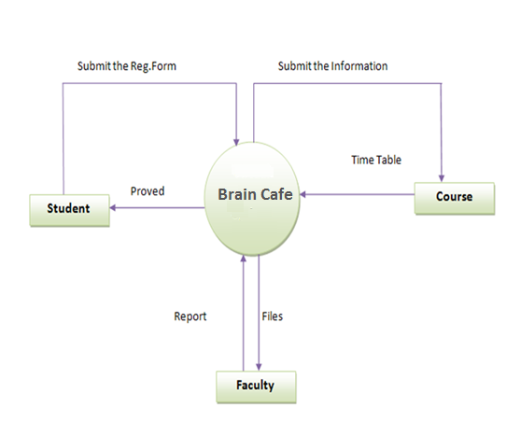
Zero Level DFD

Slide 13
First Level DFD:-
Student
Username &
Password
Examiner
Examiner
database
Logs in
Username &
Password
Logs in
Verification
Of
Username &
Password
Checks
Question
Paper
User details
Result
User details
Registration
Checked
Question paper
details
Student
database
Provides
marks
Centre
database
Select
course
Course
database
Marks
details
Select
centre
Takes exam
paper
Provides
answer
Course details
Centre details
Exam paper
details
Answer
Administrator
Provides
Marks
detail
Creates
Marks detail
Reports
Marks info
Reports
First level DFD
Database

Slide 14
Second Level DFD:-
Student
Examiner
Username &
Password
Examiner
database
Username &
Password
Logs in
Logs in
Verification
Of
Username &
Password
Evaluates
Question
Paper
User details
Checking
details
Provides
marks
Marks
details
Result
User details
Upload
file
Uploaded
File
Student details
Administrator
Registration
Answer
Provides
Answer
Creates
Reports
Student
database
Upload
database
Takes
Exam
Paper
Selects
Centre
Details
Question
details
Database
Student report
Centre
database
Views
Course
details
Course
database
Centre details
Select
Subjects
Select
Courses
Views
Centre
Details
Course details
subject details
Selected
Course details
Centre
database
Provides
Marks
detail
Marks detail
Reports
Marks info
Second level DFD

Slide 15
Conclusion
Define the target audience and their learning preferences.
Keeping in mind that learning styles are different: visual learners, kinaesthetic learners, auditory learners E-learning courses must cater for all otherwise learners will lose interest.
Defining clear learning objectives of each and every course.
Use of interactivity/Games/Simulations
Use of real life scenarios: Meaningful information is easier to learn and remember. It is very important for the students to know where they can apply the newly received knowledge.
Assessment of the students’ motivation.

